Slide 1
Zero-Downtime deployments with Kubernetes
Mateusz Dymiński
Nokia

Slide 2
Whoami
Mateusz Dymiński
Software Developer at Nokia
8+ exp with Java
4+ exp with Go
One of the organizer GoWroc - Golang Wroclaw Meetup
Github: github.com/mateuszdyminski
Twitter: @m_dyminski
LinkedIn: linkedin.com/in/mdyminski

Slide 3
Agenda
Zero Downtime Deployment
Kubernetes
Demo Application
Graceful Shutdown
Deployments demo
Summary

Slide 4
github.com/mateuszdyminski/zero

Slide 5


Slide 6

apki u

Slide 7


Slide 8
What is this zero downtime deployment?
Deploy application to production
End user can’t notice any errors/problems during the deployment
Monitoring tools shouldn’t even notice that deployment is ongoing/done
Bugs can be fixed without any outage.
New features can be introduced without any outage.
Required for Continuous Delivery - CD

Slide 9
Zero downtime deployment types
Rolling Updates deployment
Blue/Green deployment
Canary deployment

Slide 10
Rolling Update Deployment
Rolling Update deployment is when you run new version of the application next to the old one
Have proxy or load balancer in front of your applications
One by one new application is deployed and old one is shutdown
Problem – client needs handle old and new application in the same time

Slide 11

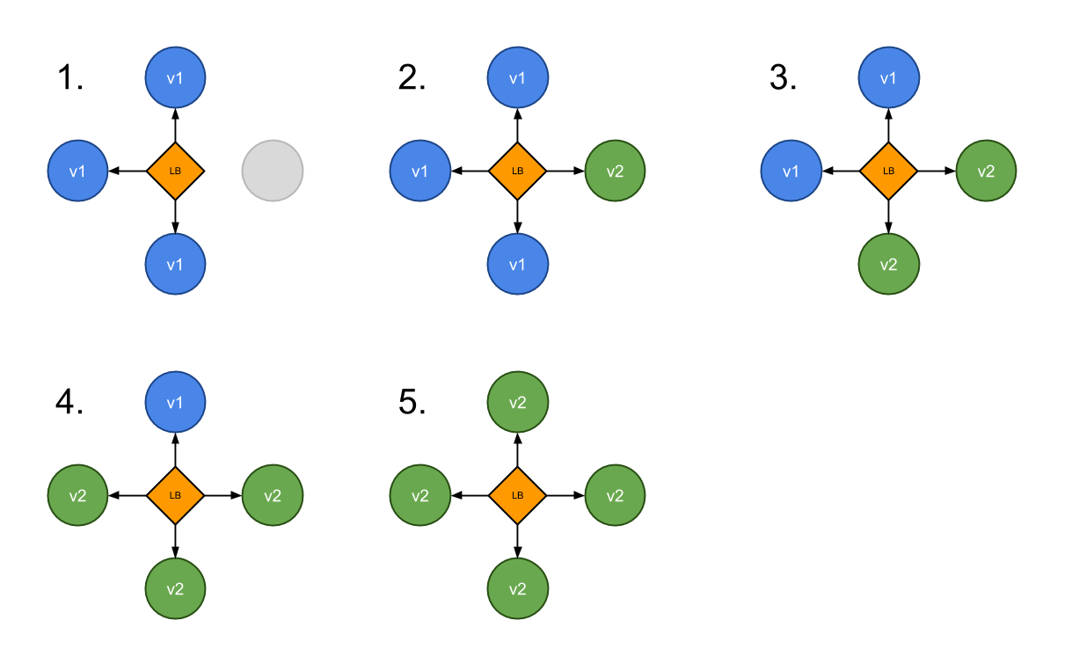
Rolling Update Deployment

Slide 12
Blue Green Deployment
A blue-green deployment is when you run two complete deployments of your application.
A deployment that is currently in production, and a deployment with the changes you want to introduce.
Have proxy or load balancer in front of your applications
Switch traffic to the new deployment when you are ready to take your changes into production.

Slide 13

Blue Green Deployment
Source: https://martinfowler.com/bliki/BlueGreenDeployment.html

Slide 14
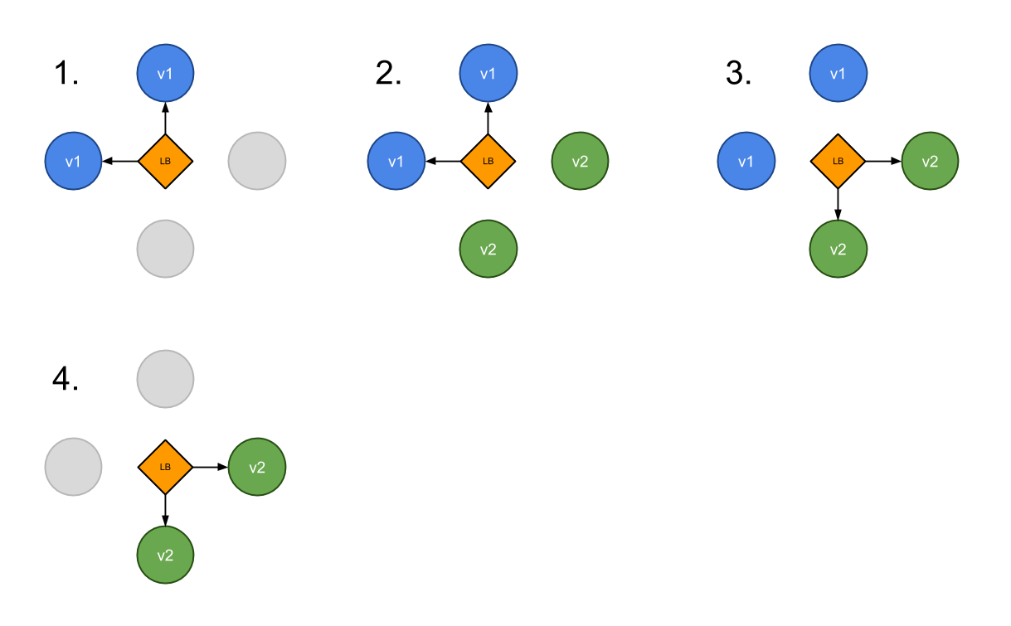
Blue Green Deployment

Slide 15
Canary Deployment
Canary deployment is when you run new version of the application next to the old one
Have proxy or load balancer in front of your applications
Some new applications are deployed next to the old ones
Part of the traffic is moved to the new application based on some rules – random, weight, cookie, http header etc.
Problem – client needs handle old and new application in the same time

Slide 16
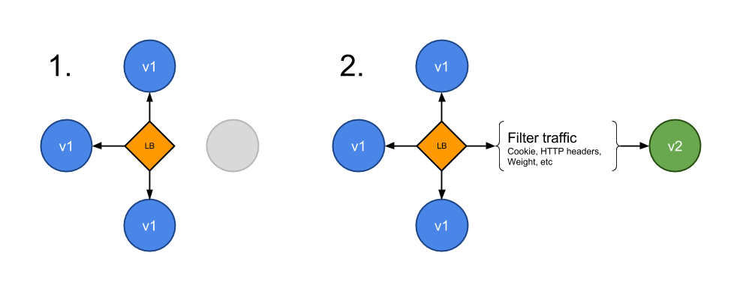
Canary Deployment

Slide 17
Who of you hears about Kubernetes?
Who of you play with Kubernetes?
Who of you is using Kubernetes on production?

Slide 18
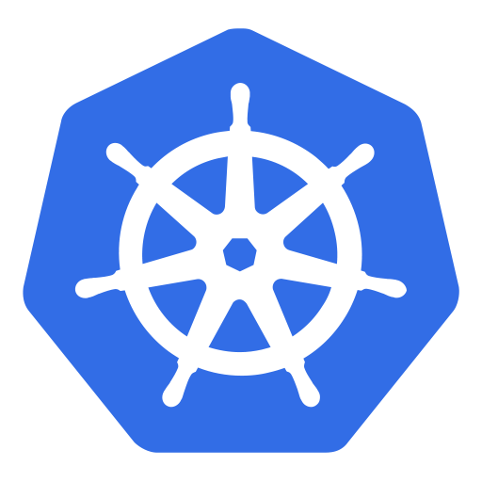
Kubernetes

Slide 19
Kubernetes
Open source platform that automates Linux container operations.
Eliminates many of the manual processes involved in deploying and scaling containerized applications.
Groups hosts running Linux containers
Kubernetes helps you easily and efficiently manage those clusters.
These clusters can span hosts across public, private, or hybrid clouds

Slide 20
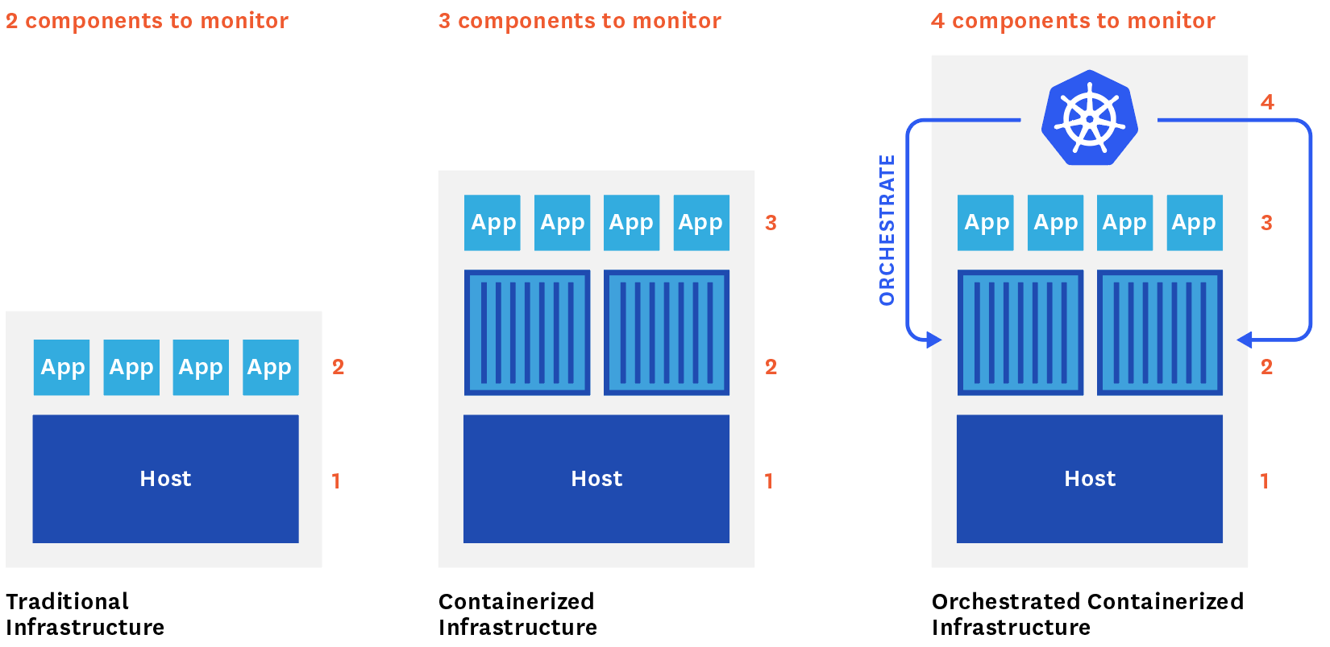

Slide 21
Why Kubernetes
Orchestrate containers across multiple hosts.
Make better use of hardware to maximize resources needed to run your enterprise apps.
Control and automate application deployments and updates.
Mount and add storage to run stateful apps.
Scale containerized applications and their resources on the fly.
Declaratively manage services, which guarantees the deployed applications are always running how you deployed them.
Health-check and self-heal your apps with autoplacement, autorestart, autoreplication, and autoscaling.

Slide 22
Demo

Slide 23
Demo Application

Slide 24
Demo Application
Users Service
REST API
Storage: MySQL

Slide 25
User
@Entity @Table(name = "users") public class User { @Id @GeneratedValue(strategy = GenerationType.IDENTITY) private Integer id; private String firstName; private String secondName; @Temporal(TemporalType.TIMESTAMP) private Date birthDate; public Integer getId() { return id; } public String getFirstName() { return firstName; } public String getSecondName() { return secondName; } public Date getBirthDate() { return birthDate; } }

Slide 26
Users Controller
@RestController @RequestMapping("/api") public class UsersController { @Autowired UserRepository userRepository; @GetMapping("/users") public List<User> getAllUsers() { return userRepository.findAll(); } @PostMapping("/users") public User createUser(@Valid @RequestBody User user) { return userRepository.save(user); } @GetMapping("/users/{id}") public User getUserById(@PathVariable(value = "id") Integer userId) { return userRepository.findById(userId) .orElseThrow(() -> new ResourceNotFoundException("User", "id", userId)); } }

Slide 27
Demo Users Service
Build Users Service
Run
Open
$ mvn package
$ java -jar target/users-1.0.0.jar
http://localhost:8080/api/users

Slide 28
Users Service on Kubernetes
Service file:
apiVersion: v1
kind: Service
metadata:
name: users-api
spec:
type: NodePort
ports:
- port: 8080
nodePort: 30001
selector:
app: users-api

Slide 29
Users Service on Kubernetes
Deployment file:
apiVersion: extensions/v1beta1
kind: Deployment
metadata:
name: users-api-deployment
spec:
replicas: 1
template:
metadata:
labels:
app: users-api
spec:
containers:
- name: users-api
image: index.docker.io/mateuszdyminski/zero-java:v1
ports:
- containerPort: 8080

Slide 30
Demo Users Service on Kubernetes
Create MySQL
Create service
Create Deployment
Open
$ helm install stable/mysql
$ kubectl apply –f 01_users_srv.yaml
$ kubectl apply –f 02_deployment.yaml
http://192.168.99.100:30001/api/users

Slide 31
Rolling update deployment

Slide 32
Rolling Update Deployment
Deployment file:
apiVersion: extensions/v1beta1
kind: Deployment
metadata:
name: users-api-deployment
spec:
replicas: 1
strategy:
type: RollingUpdate
rollingUpdate:
maxUnavailable: 0
maxSurge: 1
template:
metadata:
labels:
app: users-api
spec:
containers:
- name: users-api
image: index.docker.io/mateuszdyminski/zero-java:v1
ports:
- containerPort: 8080
Rolling Update

Slide 33
maxUnavailable and maxSurge
maxUnavailable:
The number of pods that may be unavailable during the deployment. This is relative to the desired number, specified in replicas.
It can be either an absolute number or a percentage.
It should obviously be lower than the number of replicas, or no pods may remain available during the update.
maxSurge:
The (additional) number of pods that can be created, on top of the desired number of replicas.
This too can be either an absolute number or a percentage.
A higher number may speed up the deployment, but will also require more system resources.

Slide 34
Rolling update deployment
Deploy new version of our Application:
To check if it’s Zero-Downtime:
$ kubectl set image deployments/users-api-deployment users-api=mateuszdyminski/zero-java:v2
$ wrk -c 10 -d 50s http://192.168.99.100:30001/api/users/1 &
$ sleep 1 &&
$ kubectl set image deployments/users-api-deployment users-api=mateuszdyminski/zero-java:v2

Slide 35
Graceful Shutdown

Slide 36
Graceful Shutdown
We can speak about the graceful shutdown of our application, when all of the resources it used and all of the traffic and/or data processing what it handled are closed and released properly.
It means that no database connection remains open and no ongoing request fails because we stop our application.

Slide 37
Scenario for a graceful web server shutdown
App gets notification to stop (received SIGTERM)
App lets know the load balancer that it’s not ready for newer requests
App served all the ongoing requests
App releases all of the resources correctly: DB, queue, etc.
App exits with "success" status code - usually ”0” - zero

Slide 38
Graceful Shutdown with Kubernetes
App receives SIGTERM signal because Kubernetes wants to stop it
App (pod) starts to return 500 for GET /health to let readinessProbe(Service) know that it's not ready to receive more requests.
Kubernetes readinessProbe checks GET /health and it stops redirecting traffic to the app (because it continuously returns 500)
App waits before it starts to shutdown - to make sure that the Service is getting notified via readinessProbe fail
App starts graceful shutdown
App first closes server with live working DB connections
App exits process
Kubernetes force kills the application after 30s (SIGKILL) if it's still running (in an optimal case it doesn't happen)

Slide 39
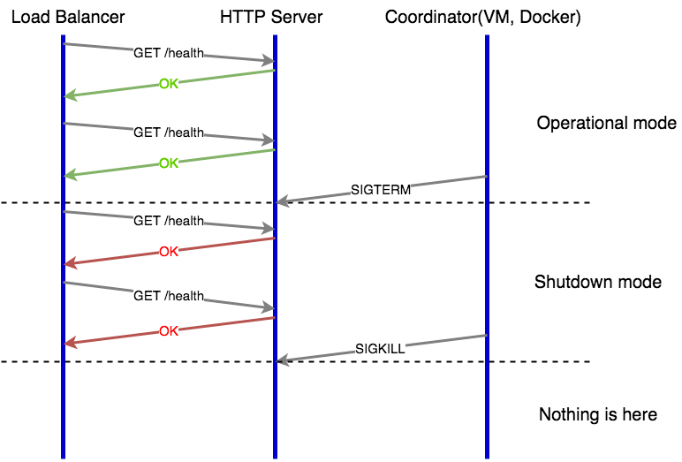
Web Server Graceful Shutdown

Slide 40
Graceful shutdown with Spring
Instead of:
We need to use:
Where GracefulshutdownSpringApplication looks like:
public static void main(String[] args) { SpringApplication.run(UsersApplication.class, args); }
public static void main(String[] args) { GracefulshutdownSpringApplication.run(UsersApplication.class, args); }
public class GracefulshutdownSpringApplication { public static void run(Class<?> appClazz, String... args) { SpringApplication app = new SpringApplication(appClazz); app.setRegisterShutdownHook(false); ConfigurableApplicationContext applicationContext = app.run(args); Runtime.getRuntime().addShutdownHook(new Thread(new GracefulShutdownHook(applicationContext))); } }

Slide 41
Graceful Shutdown with Spring
class GracefulShutdownHook implements Runnable { GracefulShutdownHook(ConfigurableApplicationContext applicationContext) { this.applicationContext = applicationContext; }
public void run() { setReadynessToFalse(); delayShutdownSpringContext(); applicationContext.close(); }
private void setReadynessToFalse() { Map<String,IProbeController> probeControllers=applicationContext.getBeansOfType(IProbeController.class); for (IProbeController probeController : probeControllers.values()) { probeController.setReady(false); } } private void delayShutdownSpringContext() { try { Thread.sleep(20* 1000); } catch (InterruptedException e) { log.error("Error while gracefulshutdown Thread.sleep", e); } }

Slide 42
Rolling update deployment – Final Test
Final Test
$ wrk -c 10 -d 50s http://192.168.99.100:30001/api/users/1 &
$ sleep 1 &&
$ kubectl set image deployments/users-api-deployment users-api=mateuszdyminski/zero-java:v3

Slide 43
Blue Green Deployment

Slide 44
Blue Green Deployment

Slide 45
Users Service on Kubernetes
Service file:
apiVersion: v1
kind: Service
metadata:
name: users-api-bg
labels:
app: users-api
spec:
type: NodePort
ports:
- port: 8080
nodePort: 30002
selector:
app: users-api-blue
blue

Slide 46
Users Service on Kubernetes
Deployment file:
apiVersion: extensions/v1beta1
kind: Deployment
metadata:
name: users-api-deployment-bg
spec:
replicas: 1
template:
metadata:
labels:
app: users-api-blue
spec:
containers:
- name: users-api-blue
image: index.docker.io/mateuszdyminski/zero-java:v1
ports:
- containerPort: 8080
blue

Slide 47
Blue Deployment
Create service
Create Deployment
Open
$ kubectl apply –f 04_bg_srv.yaml
$ kubectl apply –f 05_blue_deployment.yaml
http://192.168.99.100:30002/api/users

Slide 48
Blue Green Deployment

Slide 49
Green Deployment
Create service
Create Deployment
Open
$ kubectl apply –f 07_green_srv.yaml
$ kubectl apply –f 06_green_deployment.yaml
http://192.168.99.100:30003/api/users

Slide 50
Blue Green Deployment

Slide 51
Switch Environments from Blue to Green
Apply following changes into out main Service:
Then
apiVersion: v1
kind: Service
metadata:
name: users-api-bg
labels:
app: users-api
spec:
type: NodePort
ports:
- port: 8080
selector:
app: users-api-green
blue -> green
$ kubectl apply –f 04_bg_srv.yaml

Slide 52
Blue Green Deployment – Final Test
Final Test
$ wrk -c 10 -d 10s http://192.168.99.100:30002/api/users/1 &
$ sleep 1 &&
$ kubectl apply –f 04_bg_srv.yaml

Slide 53
Summary

Slide 54
Summary
Zero Downtime Deployments are really easy with Kubernetes
Remember to check if your Server/App handles SIGTERM properly
Always remember about Graceful Shutdown

Slide 55


Slide 56
Thank you!

